Slide 1






VISVESVRAYA TECHNOLOGICAL University RAJARAJESWARI COLLEGE OF ENGINEERING #14,Ramohalli cross, Mysore Road,Kumbalgodu,60074 affiliated to VTU, Belagavi, Approved by AICTE, New Delhi (Accredited by NAAC ‘A+’ Grade and NBA)
DEPARTEMENT OF ELECTRICAL AND ELECTRONICS ENGINEERING
SUBJECT CODE: 21EEP584
TOPIC: “SOLAR CAP WITH MOBILE CHARGING”
Presented By: Under the guidance of :
Bhumika K Ramesh (1RR21EE004) Prof. Kiruthika K
Vishal G (1RR21EE013) Assistant Professor
Department of EEE

Slide 2


CONTENTS
ABSTRACT
INTRODUCTION
LITERATURE SURVEY
BLOCK DIAGRAM
CIRCUIT DIAGRAM
COMPONENTS
WORKING PRINCIPLE
ADVANTAGES & DISADVANTAGES
REFERENCES

Slide 3
ABSTRACT
This project explores the solar cap benefits to its users. The reason behind the main focus on this is because it is very commonly used in summer and in sports game like golf, cricket, and badminton. Even the people who are working outdoors, tourists and those who are willing to climb mountain basically prefer a cap for preventing from huge sunshine. In addition to that, electronic gadgets can also be charged even in hilly areas or any remote areas with abundant sunlight.

Slide 4
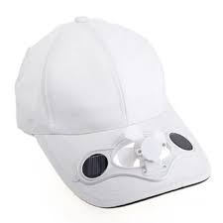
INTRODUCTION
The world is facing major issues like huge reduction of fossil fuels on daily basis.
So, solar harvesting devices like solar photovoltaic cells that are capable of producing electricity by utilization of solar energy should be used.
The aim is particularly on summer days, the users may get relaxed.
Also, it works efficiently in charging our mobile phones in remote areas.

Slide 5
LITERATURE SURVEY
SL.NO | TITLE | AUTHOR | YEAR | METHODOLOGY | PARAMETER AND INFERENCE | RESOURCE
1. | Solar Powered Fan Cap For Outdoor Workers | Badri Narayan Mohapatra | 2020 | It explores the use of solar energy to power a fan in the cap, providing cooling and protection from the sun, highlighting its potential applications and benefits for outdoor workers. | solar cells and photovoltaic panels | IEEE
2. | UR-SolarCap: An Open-Source Intelligent Auto-Wakeup Solar Energy Harvesting System for Supercapacitor Based Energy Buffering | Moeen Hassanalieragh | 2017 | an open-source energy harvesting system using solar panels and supercapacitors | battery-less sensor networks, and power management techniques | IEEE
3. | Autonomous Solar Smart Cap (ASSC) for Pedestrian Safety | Ekambir Sidhu | 2017 | Use of super capacitors for buffering solar energy in self-sustainable field systems is discussed, highlighting advantages over conventional battery-based energy storage. | solar energy harvesting, power management systems | IEEE
4. | SOLARCAP: Super Capacitor Buffering of Solar Energy for Self-Sustainable Field Systems | Amal Fahad | 2012 | Feasibility of using supercapacitors for solar energy buffering in self-sustainable field systems is discussed, along with the development of control software for managing energy flow and powering a computing board. | mobile-cloudlet-cloud acceleration | IEEE
5. | Solar cycle dependence of polar cap patch activity | B. S. Dandekar | 2000 | polar cap patch activity changes significantly over a solar cycle and is dependent on solar activity levels. | Solar power stored in battery | IEEE

Slide 6
BLOCK DIAGRAM
SOLAR PANELL
BUCK BOOST CONVERTER
5V REGULATOR
USB CONNECTOR
MOBLE CHARGING
BATTERY
FAN

Slide 7
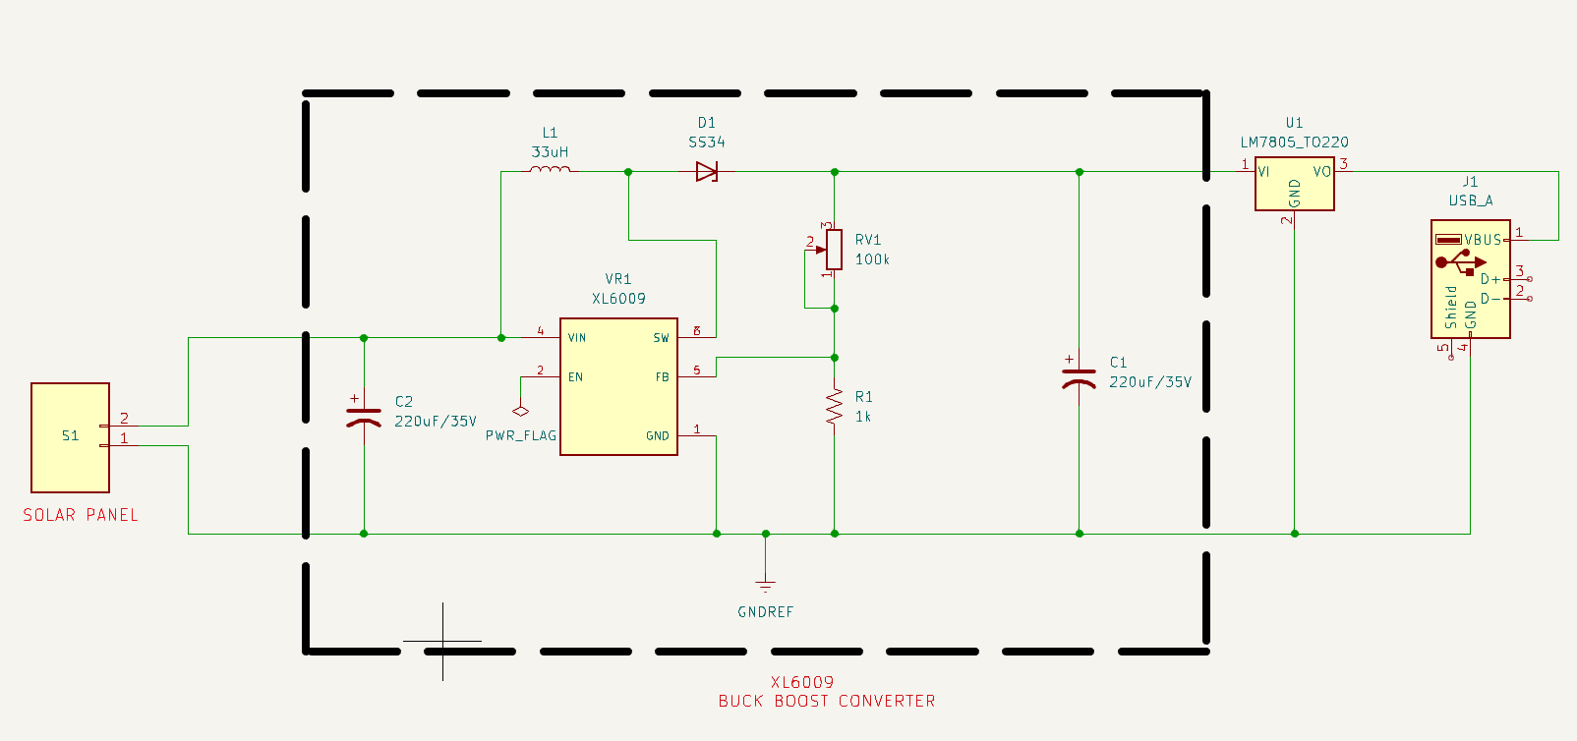
CIRCUIT DIAGRAM

Slide 8
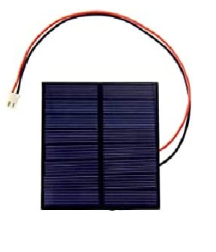
COMPONENTS
SOLAR PANEL
It converts sunlight into electricity using PV(Photovoltaic)Cells

Slide 9
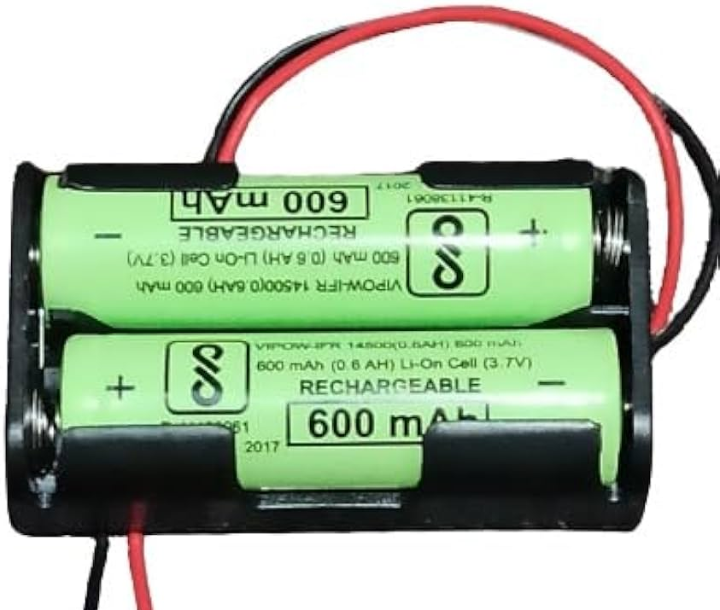
COMPONENTS
RECHARGABLE BATTERIES
The Battery is used to energize the fan which is connected to the cap (i.e Solar Cap)

Slide 10
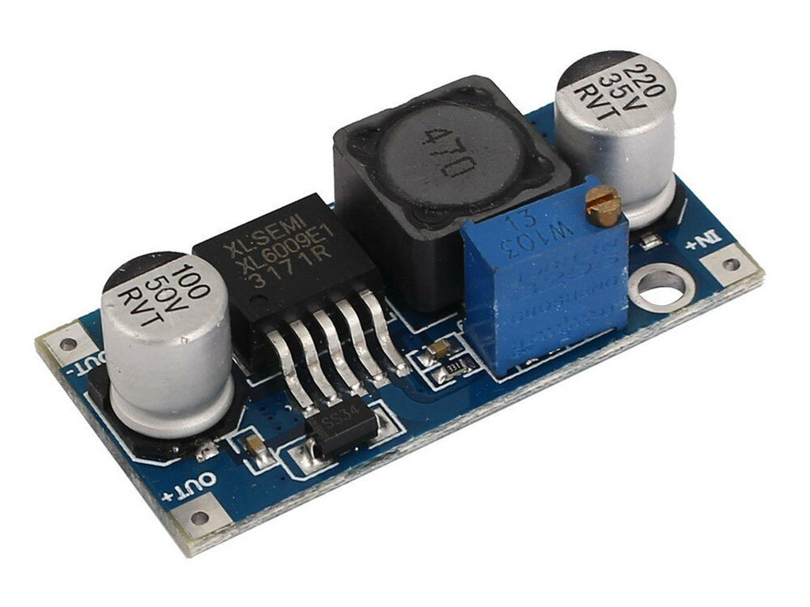
COMPONENTS
BUCK-BOOST CONVERTER
A buck-boost converter is a type of DC-DC converter that can step up or step-down voltage levels efficiently, making it useful for maintaining stable power supply in systems with varying input voltages.

Slide 11
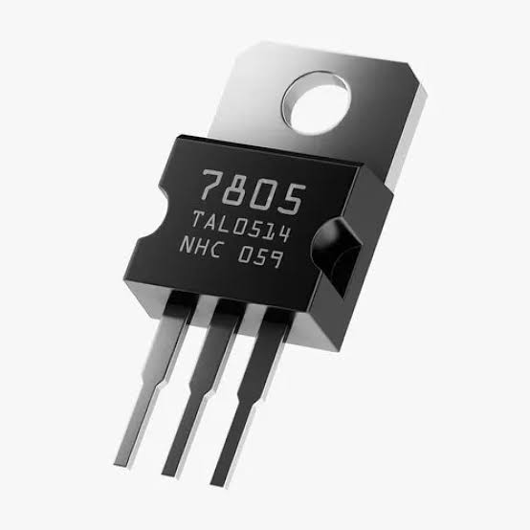
COMPONENTS
5V REGULATOR
The 5V regulator (7805) is used to regulate the produced voltage into 5V DC to supply energy to the mobile charger & fan

Slide 12
WORKING PRINCIPLE
The solar panel converts sunlight into electrical energy.
This energy is stored in the battery.
Battery power is used to run the fan.
It is also connected to the charging module wherein devices upto 5V can be charged.

Slide 13
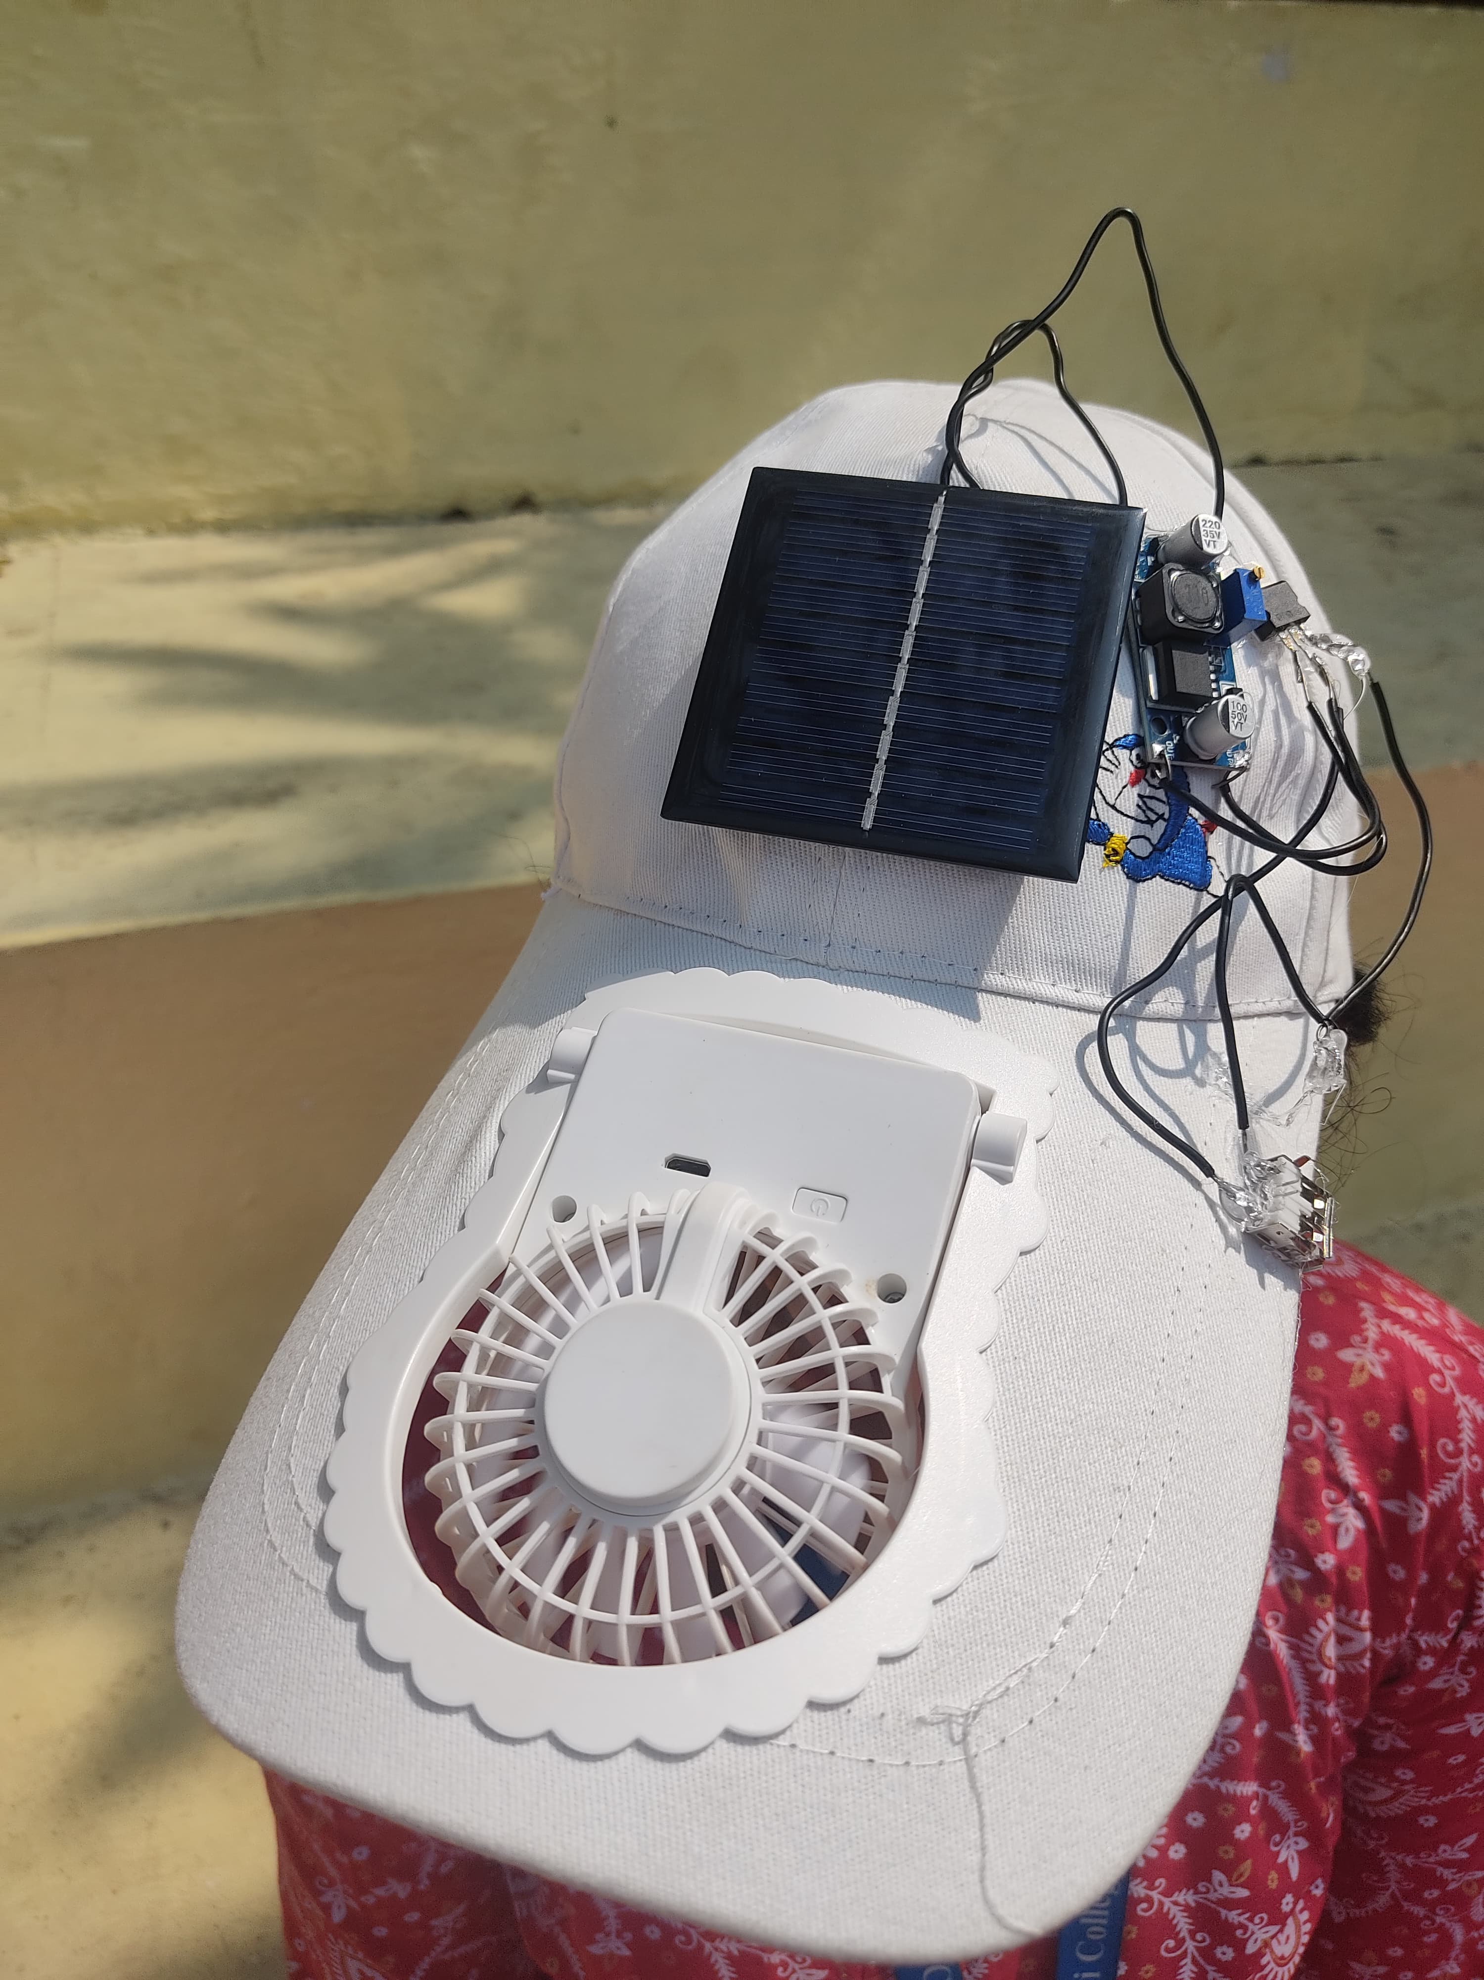
RESULTS
We are getting 5.2V from the solar panel
We are boosting the voltage using buck boost converter to around 12V
The output of the buck boost is given to LM7805 Voltage Regulator to regulate the voltage for 5V
The output of the regulator is given to the USB header to power up the applications
13

Slide 14
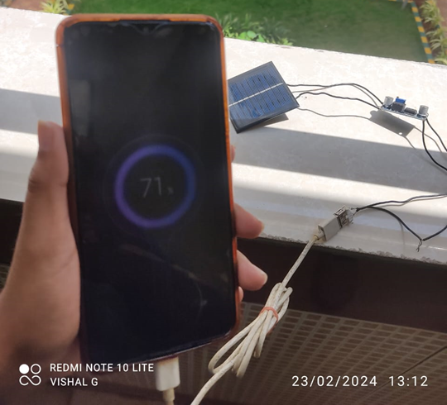
MOBILE CHARGING

Slide 15
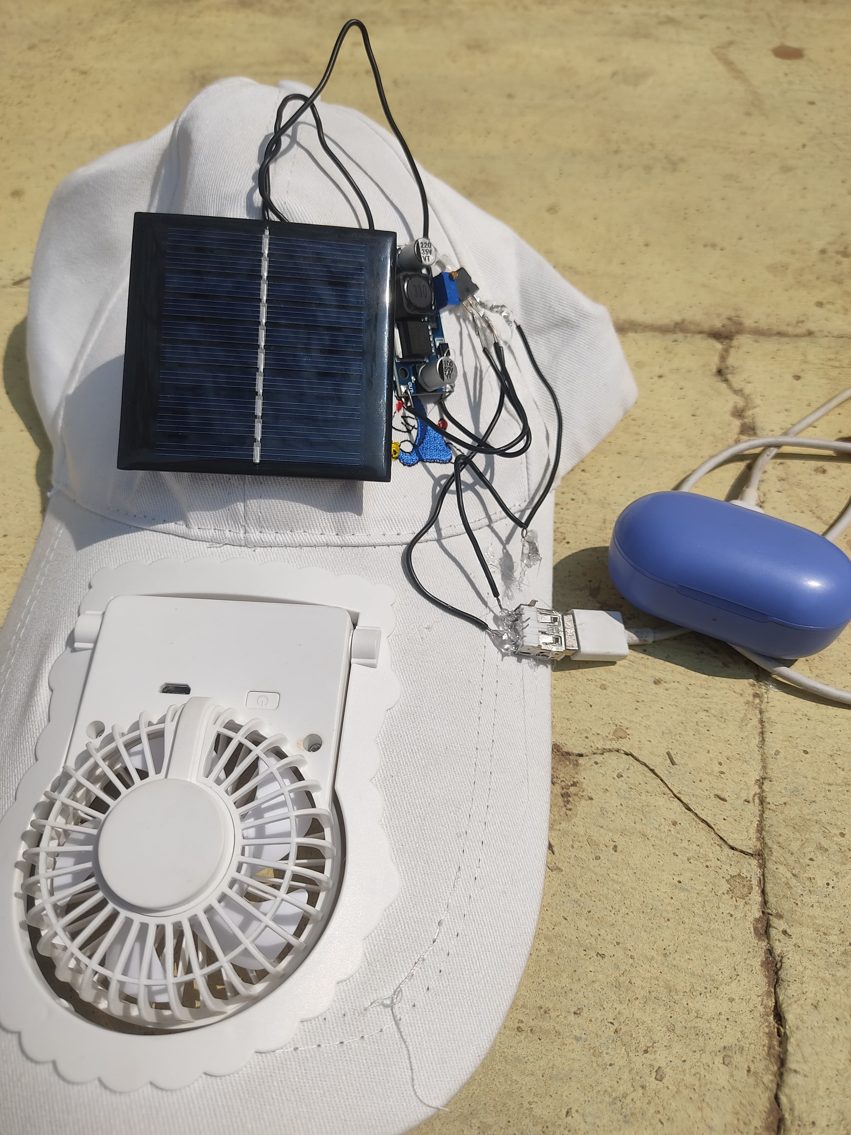
AIRPODS CHARGING

Slide 16
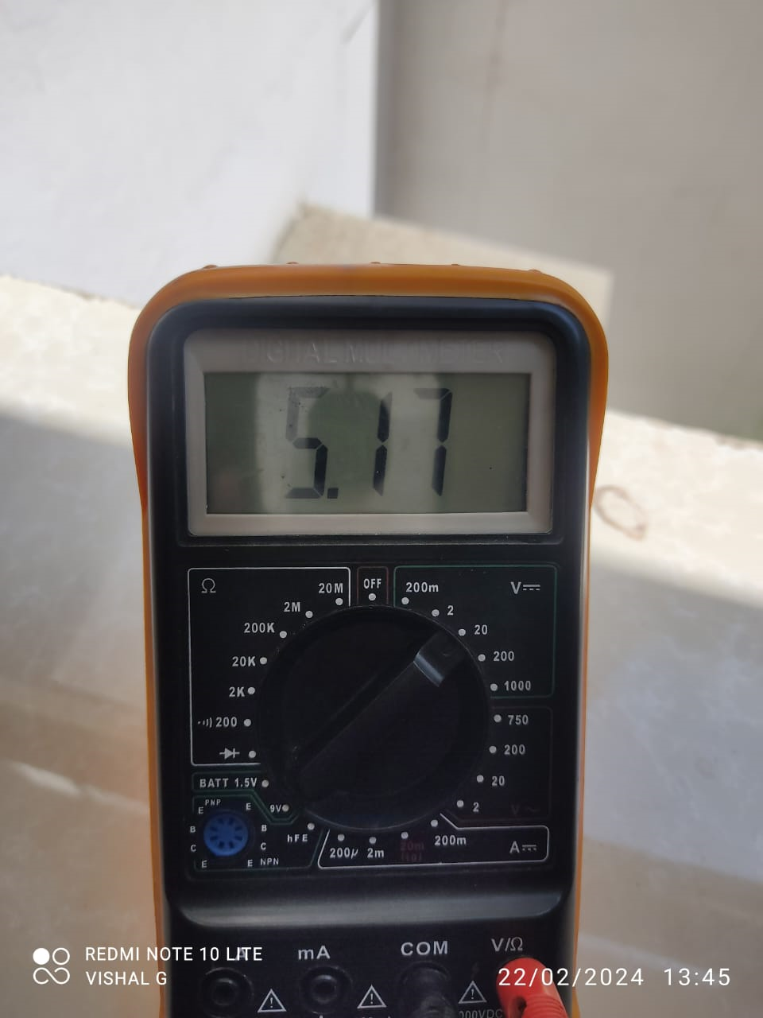
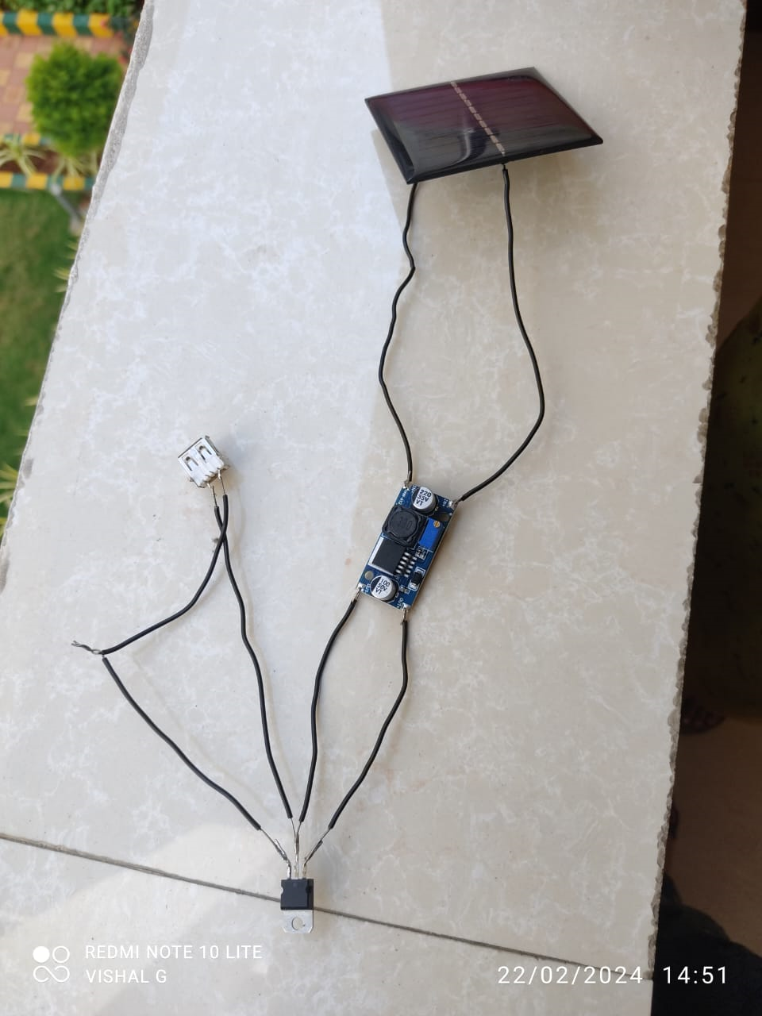
RESULTS

Slide 17
RESULTS

Slide 18
ADVANTAGES & DISADVANTAGES
ADVANTAGES
Portable Power Source
Convenience
Environmentally Friendly
Versatility
Use of Renewable Energy
Less Cost
DISADVANTAGES
Limited Power Generation
Dependence of Sunlight
Limited Battery Storage

Slide 19
FUTURE SCOPE
Integration with Smart technologies
Pedestrian safety
Direction guidance

Slide 20
REFERENCES
[1] Solar cycle dependence of polar cap patch activity Received 19 September 2000; revised 16 March 2001; accepted 25 October 2001; published 21 February 2002. B. S. Dandekar
[2] SOLARCAP: Super Capacitor Buffering of Solar Energy for Self-Sustainable Field Systems Amal Fahad,Tolga Soyata,Tai Wang, Gaurav Sharma, Wendi Heinzelman, Kai Shen
]3] Autonomous Solar Smart Cap (ASSC) for Pedestrian Safety Sidhu, Assistant Professor (IEEE member), Department of Electronics and Communication Engineering Punjabi University Patiala-2017 IEEE
[4] UR-SolarCap: An Open-Source Intelligent Auto-Wakeup Solar Energy Harvesting System for Supercapacitor Based Energy Buffering Moeen Hassanalieragh, Tolga Soyata, Andrew Nadeau, Gaurav Sharma, Department of Electrical and Computer Engineering, University of Rochester, Rochester-2017 IEE
[5] Solar Powered Fan Cap For Outdoor Workers, Badri Narayan Mohapatra,Department of Instrumentation, AISSMS IOIT, Pune, INDIA,10, January 2020-IEEE

Slide 21
THANK YOU

